Slide 1



INSTITUTE: UIE (AIT-CSE)
CSS21: B.E. CSE (H) with specialization in Artificial Intelligence & Machine Learning
Advanced Machine Learning (20CSF-349)
Chapter 2.3.3 & 2.3.4:Neural Networks
Lecture 26 & 27:Backpropagation,
Training & Validation
By: Mr. Siddharth Kumar
DISCOVER . LEARN . EMPOWER

Slide 2
Advanced Machine Learning
Course Outcome
CO | Title
1 | Have a good understanding of the fundamental issues and challenges of machine learning: data, model selection, model complexity, etc.
2 | Appreciate the underlying mathematical relationships within and across Machine Learning algorithms and the paradigms of supervised and un-supervised learning
3 | Design and implement various machine learning algorithms in a range of real-world applications.
4 | Design and evaluate intelligent expert models for perception and prediction using machine learning algorithms
5 | Analyze and make use of machine learning algorithms-based applications using performance

Slide 3
What is Backpropagation?
Backpropagation is the essence of neural network training. It is the method of fine-tuning the weights of a neural network based on the error rate obtained in the previous epoch (i.e., iteration). Proper tuning of the weights allows you to reduce error rates and make the model reliable by increasing its generalization.
Backpropagation in neural network is a short form for “backward propagation of errors.” It is a standard method of training artificial neural networks. This method helps calculate the gradient of a loss function with respect to all the weights in the network.
How Backpropagation Algorithm Works
The Back propagation algorithm in neural network computes the gradient of the loss function for a single weight by the chain rule. It efficiently computes one layer at a time, unlike a native direct computation. It computes the gradient, but it does not define how the gradient is used. It generalizes the computation in the delta rule.

Slide 4
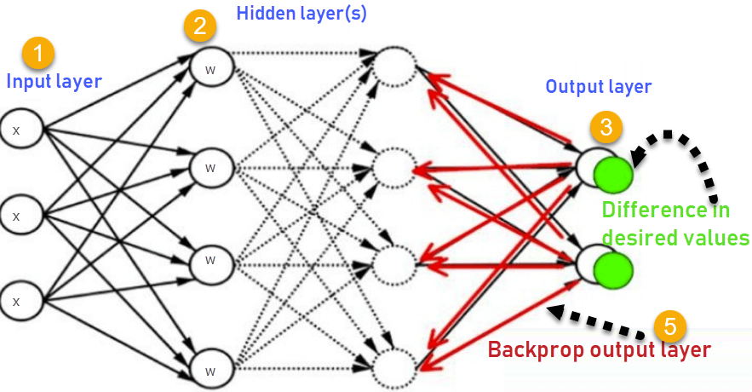
What is Artificial Neural Network?
Consider the following Back propagation neural network example diagram to understand:
How Backpropagation Algorithm Works

Slide 5
Inputs X, arrive through the preconnected path
Input is modeled using real weights W. The weights are usually randomly selected.
Calculate the output for every neuron from the input layer, to the hidden layers, to the output layer.
Calculate the error in the outputs
ErrorB= Actual Output – Desired Output
Travel back from the output layer to the hidden layer to adjust the weights such that the error is decreased. Keep repeating the process until the desired output is achieved.
Why We Need Backpropagation?
It has no parameters to tune apart from the numbers of input | It is a standard method that generally works well
It is a flexible method as it does not require prior knowledge about the network | It does not need any special mention of the features of the function to be learned.
Backpropagation is fast, simple and easy to program

Slide 6
Types of Backpropagation Networks
Two Types of Backpropagation Networks are:
Static Back-propagation
Recurrent Backpropagation
Static back-propagation: It is one kind of backpropagation network which produces a mapping of a static input for static output. It is useful to solve static classification issues like optical character recognition.
Recurrent Backpropagation: Recurrent Back propagation in data mining is fed forward until a fixed value is achieved. After that, the error is computed and propagated backward.
The main difference between both of these methods is: that the mapping is rapid in static back-propagation while it is non-static in recurrent backpropagation.

Slide 7
History of Backpropagation
In 1961, the basics concept of continuous backpropagation were derived in the context of control theory by J. Kelly, Henry Arthur, and E. Bryson.
In 1969, Bryson and Ho gave a multi-stage dynamic system optimization method.
In 1974, Werbos stated the possibility of applying this principle in an artificial neural network.
In 1982, Hopfield brought his idea of a neural network.
In 1986, by the effort of David E. Rumelhart, Geoffrey E. Hinton, Ronald J. Williams, backpropagation gained recognition.
In 1993, Wan was the first person to win an international pattern recognition contest with the help of the backpropagation method.
Backpropagation Key Points
Simplifies the network structure by elements weighted links that have the least effect on the trained network

Slide 8
You need to study a group of input and activation values to develop the relationship between the input and hidden unit layers.
It helps to assess the impact that a given input variable has on a network output. The knowledge gained from this analysis should be represented in rules.
Backpropagation is especially useful for deep neural networks working on error-prone projects, such as image or speech recognition.
Backpropagation takes advantage of the chain and power rules allows backpropagation to function with any number of outputs.
Disadvantages of using Backpropagation
The actual performance of backpropagation on a specific problem is dependent on the input data.
Back propagation algorithm in data mining can be quite sensitive to noisy data
You need to use the matrix-based approach for backpropagation instead of mini-batch.

Slide 9
Training & Validation in ANN
The train-validate-test process is hard to sum up in a few words, but trust me that you'll want to know how it's done to avoid the issue of model overfitting when making predictions on new data.
The neural network train-validate-test process is a technique used to reduce model overfitting. The technique is also called early stopping. Although train-validate-test isn't conceptually difficult, the process is a bit difficult to explain because there are several inter-related ideas involved.
Training a neural network is the process of finding the values for the weights and biases. In most scenarios, training is accomplished using what can be described as a train-test technique. The available data, which has known input and output values, is split into a training set and a test set.
The training data set is used to train the neural network. Various values of the weights and biases are checked to find the set of values so that the computed output values most closely match the known, correct output values. Or, put slightly differently, training is the process of finding values for the weights and biases so that error is minimized.

Slide 10
During training, the test data is not used at all. After training completes, the accuracy of the resulting neural network model's weights and biases are applied just once to the test data. The accuracy of the model on the test data gives you a very rough estimate of how accurate the model will be when presented with new, previously unseen data.
One of the major challenges when working with neural networks is a phenomenon called overfitting. Model overfitting occurs when the training algorithm runs too long. The result is a set of values for the weights and biases that generate outputs that almost perfectly match the training data, but when those weights and bias values are used to make predictions on new data, the model has very poor accuracy.
The train-validate-test process is designed to help identify when model overfitting starts to occur, so that training can be stopped. Instead of splitting the available data into two sets, train and test, the data is split into three sets: a training set (typically 70 percent of the data), a validation set (15 percent) and a test set (15 percent).

Slide 11
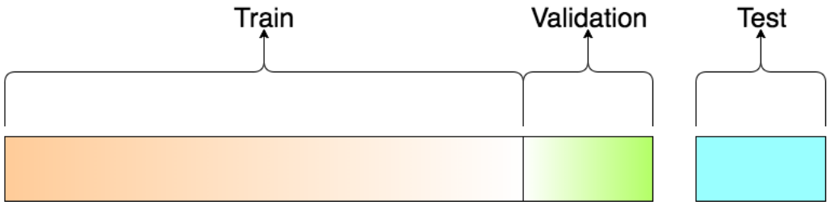
About the dataset split ratio: Now that you know what these datasets do, you might be looking for recommendations on how to split your dataset into Train, Validation and Test sets.
This mainly depends on 2 things. First, the total number of samples in your data and second, on the actual model you are training.
Some models need substantial data to train, so in this case you would optimize for the larger training sets.
Models with very few hyperparameters will be easy to validate and tune, so you can probably reduce the size of your validation set, but if your model has many hyperparameters, you would want to have a large validation set as well(although you should also consider cross validation).

Slide 12
References
T1: Mitchell T.M., Machine Learning, McGraw Hill (1997).
T2: Andreas C. Miller, Sarah Guido, Introduction to Machine Learning with Python, O’REILLY (2001).
Notes:
Introduction to Cyber Security (simplilearn.com)

Slide 13

THANK YOU

